Slide 1
Graphing - Introduction

Slide 2
Graphs
Graphing of data is something that is not only important in chemistry, but nearly every field.
Understanding how to create and read a graph would be useful (if not required) in engineering, the medical field, the sciences, psychology, sociology, kinesiology, history, politics, and many others.
Graphs are used to display a large amount of data in a quick way, that is easily interpreted and understood.
There are many styles of graphs and choosing one will depend on the data as well as the information wanting to be highlighted
In this course, the all graphs will use the Scatter Plot format

Slide 3
Linear graphs
Many of the graphs in the course will display linear relationships between data sets.
Linear data on a graph will give the equation y = mx + b
Y is the value of the Y-Axis (Vertical Axis)
X is the value of the X-Axis (Horizontal Axis)
m is the slope value, or the constant ratio of how the values are related
b is the Y-Intercept value, or where the data will cross the Y-Axis line

Slide 4
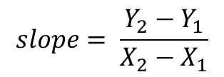
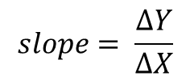
Calculating slope
The slope of a straight line, is the rate at which the Y value changes with respect to X.
If the X value is increased by 1 and the Y value increases by 1, then the slope would be 1
If the X value is increased by 2 and the Y value increases by 1, then the slope would be 0.5
Any two points, connected together will make a straight line, from which a slope can be calculated.
When determining slope from a set of data, the slope should be calculated from points directly on the line of best fit, and not necessarily individual data points
On a cartesian plane, the X and Y values of a point are given in parenthesis (X, Y)
From two separate points on a line, you can calculate the change in Y values and the change in X values between the two points to calculate the slope
$$slope= \frac{∆Y}{∆X}$$
$$slope= \frac{Y_{2}−Y_{1}}{X_{2}−X_{1}}$$

Slide 5
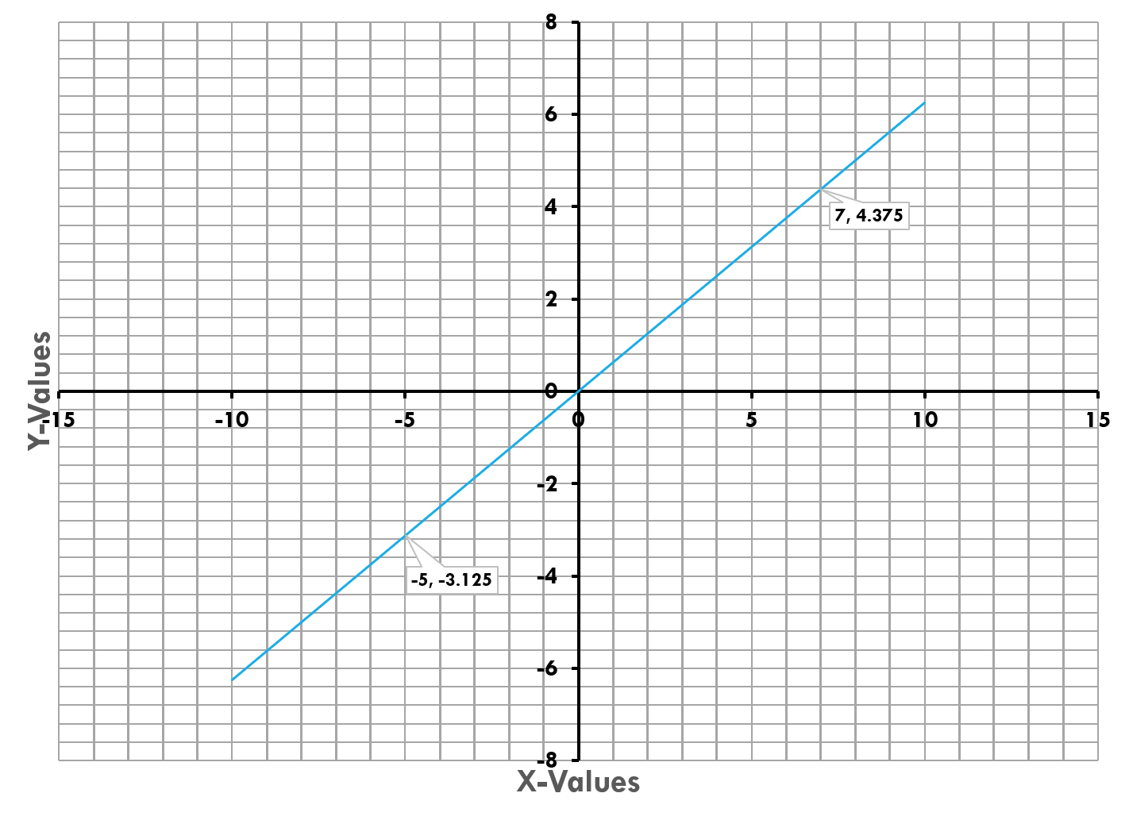
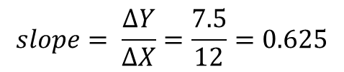
Calculating slope
The graph to the left has two data points given
Point 1 = (-5, -3.125) & Point 2 = (7, 4.375)
The change in the Y value
$$∆Y= Y_{2}−Y_{1}=\left(4.375−{}_{ }^{−}{3.125}\right)=7.5$$
The change in the X value
$$∆X= X_{2}−X_{1}=(7−{}_{ }^{−}{5)=\left(7+5\right)=12}$$
$$slope= \frac{∆Y}{∆X}=\frac{7.5}{12}=0.625$$
This slope value would be true for any two points chosen along this line
What is each block worth in the X direction?
What is each block worth in the Y direction?

Slide 6
Calculating intercept
While the slope defines the rate of change between the X and Y values (the tilt of the line), the Intercept is the overall position of the line, up and down on the Cartesian Plane
The previous graph had an intercept of 0, therefore the equation for that line was y=0.625x + 0
If the intercept is 0, the line passes directly through the origin point where the X and Y axis cross each other.
The intercept can be calculated using the slope and a single data point (x and y values) on the line itself.
When calculating intercept from a set of data, the slope must be determined first.

Slide 7
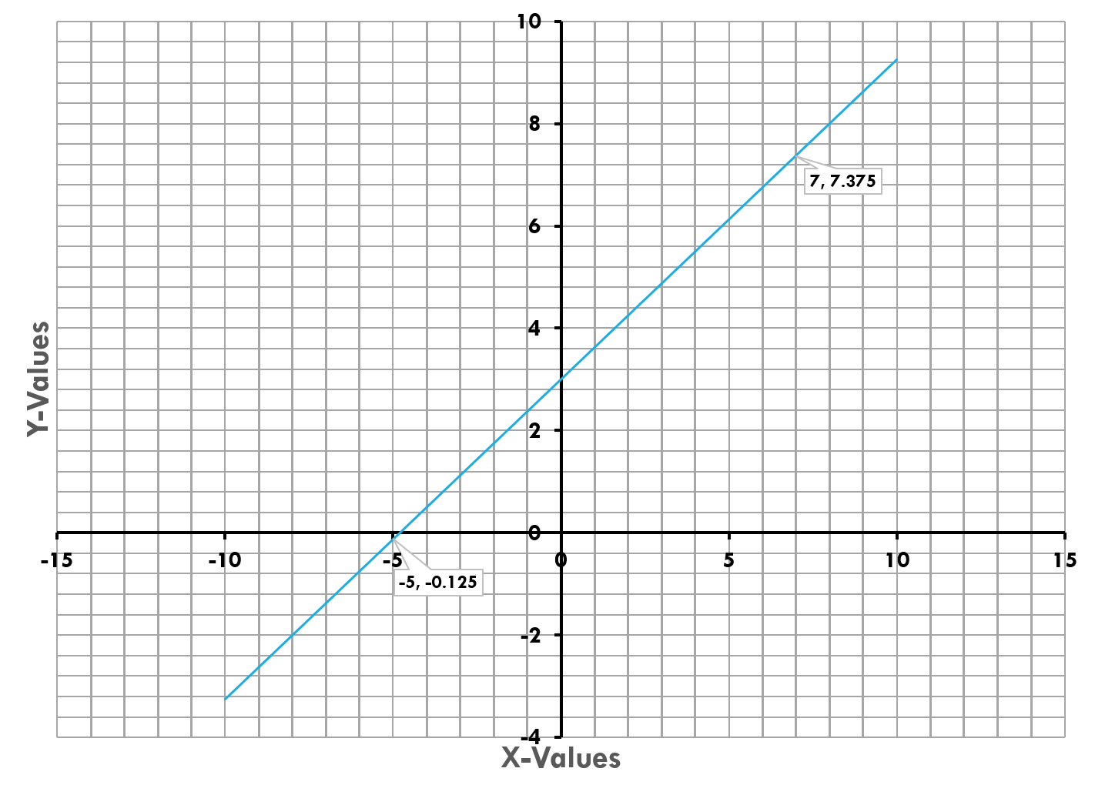





Calculating intercept
In this graph, the slope of the line is still 0.625, but the line no longer crosses the Y-Axis through the origin
The straight line has the standard equation of:
$$y=mx+b$$
With m being the slope. Based on the slope value calculated of 0.625, the equation for this line would be
$$y=0.625x+b$$
Choosing any data point on the line, such as (7, 7.375) and plugging the x and y values in the equation, the intercept (b) can be solved for
$$7.375=\left(0.625\right)\left(7\right)+b$$
$$7.375=4.375+b$$
$$b=3$$

Slide 8
Preparing graphs
When preparing your own graph from a set of data, you may need to determine which set of data should be the X-axis, and which should be the Y-axis
The X-axis should be the variable that you are controlling in a lab setting
This could be things like the concentration of solution that you choose to test, the volume of solution that you choose to weigh, or the frequency of light that you choose to shine on the sample.
Depending on what is plotted on the X and Y axis, the slope would be interpreted differently
Graphs should also be at the appropriate scale, if your data ranges from 1 to 10, you do not need to create a graph scale that goes to 100
The axis scales should be evenly spaced, do not label the scales with the values of your data points

Slide 9
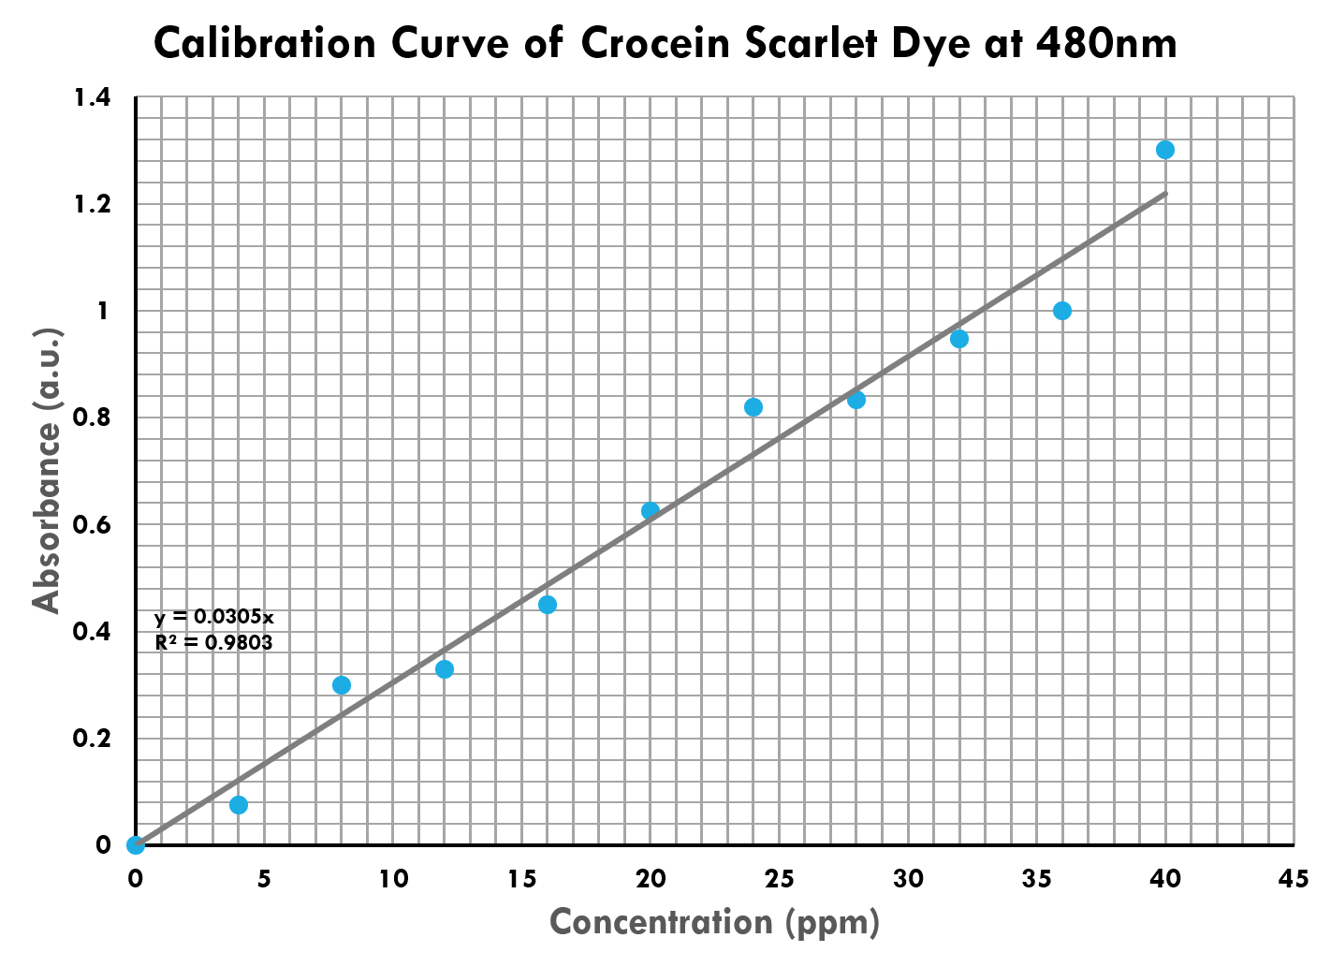
What to include on a graph
Graphs need to be labeled so that they can display the information correctly
An unlabeled graph is meaningless
The previous graphs, could be used to show how to calculate slope and intercept, but the numbers were meaningless, as the graphs were not labeled
All Graphs should include
Descriptive Graph Title, including any variables that are constant
Both an X and Y Axis title, including units
All data points
A smooth line looks nice, but what points on it are your data and which are just a connection?
A Trendline through the data
This smooth line is the best approximation for a function from your data
Other options on graphs that are nice to include but not always necessary would be
Gridlines
A legend to identify multiple lines on the same graph
The equation of the trendline
The R² value (a measure of how accurately the line fits the data, an R² value of 1 is perfect)

Slide 10
trendlines
A trendline is a line of best fit for your measured data. In real life measurements, there is always variability.
The trendline is the line that represents all of your data as a whole, instead of individual points.
In the example graph to the right, none of the measured data points fall on the exact trendline.
For this reason, when calculating a slope by hand, you should always choose points that fall on the trendline itself, and not your individual data points

Slide 11
Graphing - Experiment

Slide 12
Graphing data
The data that you will be graphing is real data
The values are based upon the concept of Gasses, which will be the final topic of the course
The first data set (Part A) looks at how Pressure and Volume of a gas are related
This relationship is known as Boyle’s Law
The second data set (Part B) looks at how Temperature and Volume of a gas are related
This relationship is known as Charles’s Law
The third data set (Part C) looks at the vapor pressure of a water
The vapor pressure is the amount of pressure that comes from evaporation

Slide 13


Part a – pressure & volume data
The first section involves preparing two graphs by hand during the lab session
The information describes an experiment where you change the volume (independent variable) and the pressure changes accordingly (dependent variable)
Prepare a fully labeled graph for Pressure and Volume
Determine which should be the X-Axis, and which should be the Y-Axis
Label both axis, including appropriate units
Include a title with any other information provided
Prepare a fully labeled graph for Pressure and Inverse Volume
Calculate the Inverse Volume for each data point
The inverse volume will be the same axis as the Volume from the first graph
Label both axis, including appropriate units
Include a title with any other information provided
Pressure (atm) | Volume (L) | Inverse Volume (1/L)
3.21 | 8.24 | 0.121
3.75 | 7.07
5.03 | 5.26
5.86 | 4.52
7.86 | 3.36
9.16 | 2.89
12.28 | 2.15
14.30 | 1.84
19.16 | 1.37
$$Inverse Volume= \frac{1}{Volume}$$
$$\frac{1}{8.24L}=0.121L^{−1}$$

Slide 14

Part b – Temperature vs Volume
In Part B you will prepare one graph of Temperature and Volume for a gas
The graph may be done in the lab session if you have time, otherwise is homework
The graph may be done by hand or through a graphing program (Excel, Google Sheets, etc.)
All graphs for the remainder of the course, may be done through a graphing program
Prepare a fully labeled graph for Temperature and Volume
Use the information provided to determine the Independent and Dependent variables
Label both axis, including appropriate units
Include a title with any other information provided
Calculate the Slope and Intercept of the trendline
Determine the Equation of the Trendline
Use your equation to calculate the Temperature if the Volume is zero.
Calculate the percent error based on the True Value of absolute zero (-273⁰C)
Temperature (⁰C) | Volume (mL)
11 | 95.3
25 | 100.0
47 | 107.4
73 | 116.1
159 | 145.0
233 | 169.8
258 | 178.1
$$\%Error= \frac{\left|\left(Measured Value\right)−\left(True Value\right)\right|}{\left(True Value\right)}×100\%$$

Slide 15
Part C – Vapor pressure of water
Temperature (⁰C) | Vap. Press. (mmHg)
0 | 4.6
5 | 6.5
10 | 9.2
15 | 12.8
20 | 17.5
25 | 23.8
30 | 31.8
35 | 42.2
40 | 55.3
45 | 71.9
50 | 92.5
55 | 118.0
60 | 149.4
65 | 187.5
70 | 233.7
75 | 289.1
80 | 355.1
85 | 433.6
90 | 525.8
95 | 633.9
In Part C you will prepare two graphs of Temperature and Volume for a gas
The graphs may be done in the lab session if you have time, otherwise are homework
The graphs may be done by hand or through a graphing program (Excel, Google Sheets, etc.)
All graphs for the remainder of the course, may be done through a graphing program
Prepare a fully labeled graph for Temperature and Vapor Pressure
Use the information provided to determine the Independent and Dependent variables
Label both axis, including appropriate units
Include a title with any other information provided
Run a trendline through the data (a trendline does not always need to be linear)
Continue the trendline to a vapor pressure of 760mmHg
This continuation of a line is Extrapolation
Use the graph to estimate what the temperature will be at this vapor pressure
Your estimated temperature should be the Boiling Point of water

Slide 16




Part C – Vapor pressure of water
Prepare a fully labeled graph for Inverse Temperature and Natural Log of Vapor Pressure
The inverse temperature will be the same axis as temperature
The natural log of vapor pressure will be the same axis as vapor pressure
Label both axis, including appropriate units
Include a title with any other information provided
Run a trendline through the data and determine the slope of the line
Use the slope of the trendline to calculate a property with a given equation.
Temp. (⁰C) | Vap. Pres. (mmHg) | Temp (K) | Inverse Temp (1/K) | Natural Log Vap. Pres.
0 | 4.6 | 273 | 0.00366 | 1.526
5 | 6.5 | 278 | 0.00360 | 1.872
10 | 9.2 | 283 | 0.00357 | 2.219
$$Kelvin=Celsius+273$$
$$Kelvin=0+273=273K$$
$$Inverse Temperature= \frac{1}{Temperature}$$
$$Nat. Log Vap. Pres.=ln\left(Vapor Pressure\right)$$
$$\frac{1}{273K}=0.00366K^{−1}$$
$$Nat. Log Vap. Pres.=ln\left(4.6\right)=1.526$$

Slide 17
summary
Any graphs by hand, must be done on graph paper
Parts B and C, as well as any other graphs in the course, may be done by hand or through a graphing program
Part A
Part B
Part C
Prepare two graphs by hand in the lab session
The first graph is Pressure vs Volume
The second graph is Pressure vs. Inverse Volume
Both graphs should be properly labeled
Prepare one graph of Pressure vs Volume
Determine the slope and intercept for the trendline
Use your trendline equation to determine Absolute Zero
Calculate a Percent Error
Prepare two graphs based on the vapor pressure of water
The first graph will be Temperature vs the Vapor Pressure of Water
The second graph will be the Inverse Temperature vs the Natural Log of the Vapor Pressure of Water
Extend your trendline to determine the Boiling Point of water

